Slide 1
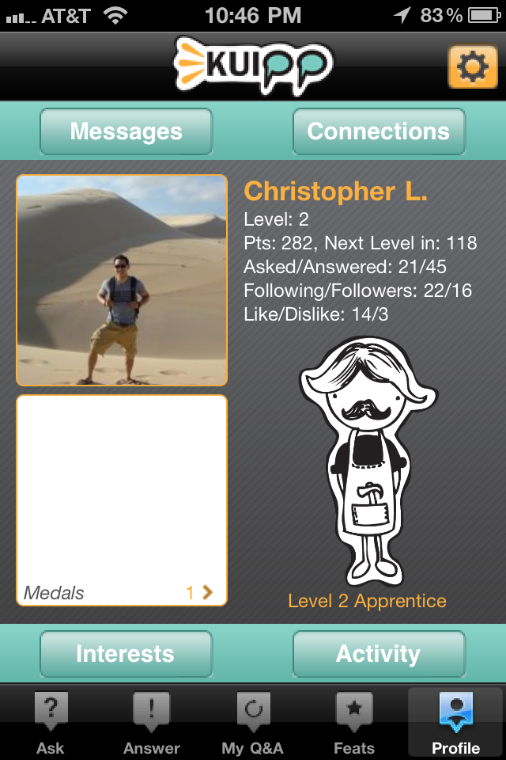
89% Influence
Medals 5
Interests 8

